Slide 1
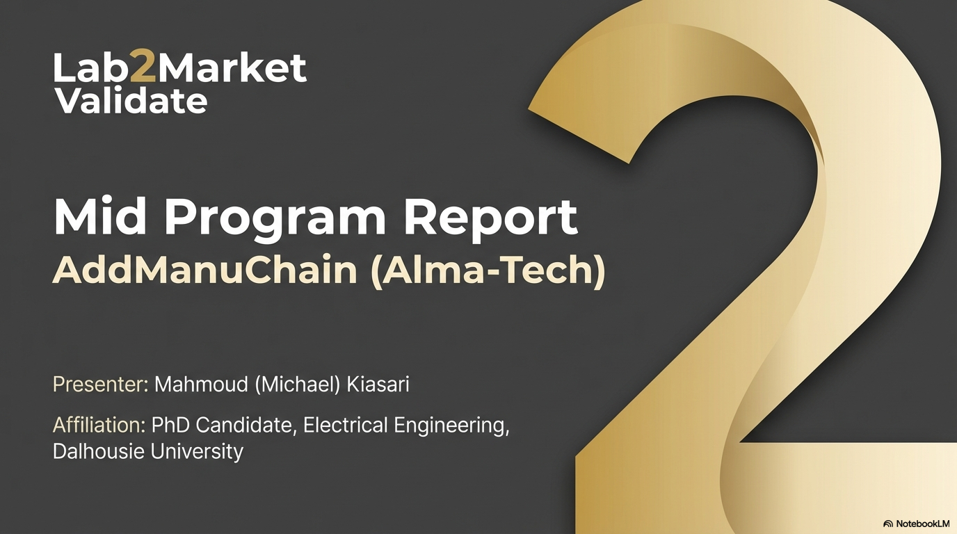








Slide 2
Business Thesis
Value Proposition:
What Changed — Sprint #1 → Sprint #2
Mid-size industrial operators in oil & gas, maritime, naval, utilities, Aerospace face a broken spare parts process — physical inventory is capital-locked, legacy ERP systems don't know what they actually have, and emergency sourcing takes weeks. AddManuChain is an AI-powered digital inventory platform that normalises parts data across fragmented systems, connects operators to certified AM facilities on demand, and delivers every part with a Digital Birth Certificate providing full traceability. Turn spare parts from a capital liability into a certified, intelligent, on-demand service.
Target: All operators → Mid-size only
Framing: Cost savings → Downtime avoided
Mining: Under study → ❌ Poor fit confirmed
Pitch opener: 'Here's our platform' → 'If this existed—would you use it?'
AI role: Feature → Central product layer
Target customer: Mid-size operators: O&G · Maritime · Naval · Utilities - Aerospace
Phase 1 product: None → AI parts normalisation (standalone)
Their problem: Downtime $100K–$2M/day; inventory is wrong & capital-locked
New sector: O&G, naval → + Maritime shipping + Aerospace
Our product: AI normalisation + certified AM sourcing + Digital Birth Certificate + Digital Ecosystem/Inventory
Benefit: Know what you have. Get what you need — certified, fast, traceable.
L2M

Slide 3
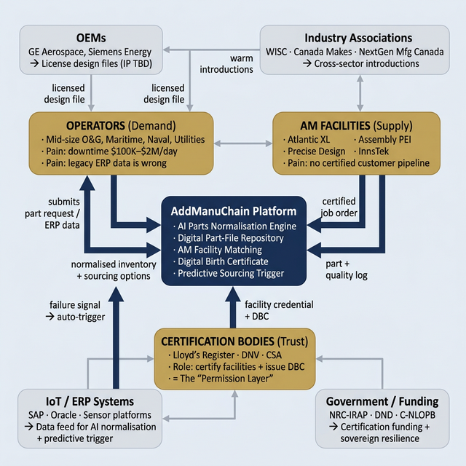
ECOSYSTEM MAP

Slide 4
Objectives for Sprint #2
What I Did to Achieve Them
1. Test: Is certification the only remaining adoption barrier? (Hyp. NH.7)
LR (Saxty, Whitehouse, Butler), GE Additive, ExxonMobil (Beatty). Tyler Beatty's Value-Capability-Permission framework confirmed certification as the only gap. ✅
2. Test: Are mid-size operators the true customer, not Tier-1 majors? (Hyp. CS.BEACHHEAD)
CNRL (Romero), ExxonMobil (Dicken), Enbridge (Dalpe). Tier-1 majors confirmed solved by scale. Pivot to mid-size made and acted upon. ✅
3. Test: Is AI parts normalisation a standalone commercial product? (Hyp. AI.CORE – NEW)
Cindy Clark (WISC) — 'Tomato Problem' identified. OMV (Chris): 'Inventory management should be fully AI-based.' Jason Power (Noble): 'No one has accomplished predictive-to-sourcing integration yet.' ✅
4. Test: Are industry associations (WISC) a viable GTM channel? (Hyp. CH.2)
Cindy Clark (WISC) committed to personal aerospace intros: WestJet, Havelin, Lufthansa Technik Calgary. ✅
5. Test: Does maritime shipping share the same spare parts pain?
André Simha (MSC CDIO) — shipboard parts pain confirmed. Pelagus 3D market signal validated. ✅
6. Scale outreach to 60+ interviews via LinkedIn + warm referral chains
279 contacts messaged, 415 total in CRM. Grew from 18 → 55 completed interviews.✅
7. Update pitch: reframe from 'here's our platform' to 'if this existed—would you use it?'
L2M

Slide 5
NUMBER OF INTERVIEWS
 | How many people have you contacted? | How many people have answered you? | Calculate your response rate (%) | Number of interviews completed | Number of interviews scheduled but not yet completed | Number of references obtained
New Interviews (since the last sprint) | 175 | 82 | 47% | 38 | 15 | 25+
TOTAL = | 415 | 128 | 46% | 57 | - | 40+

Slide 6
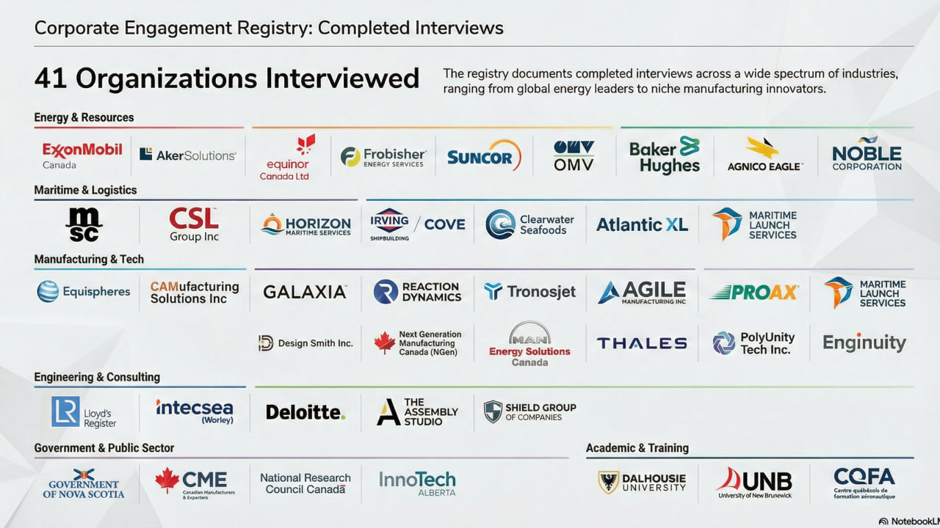

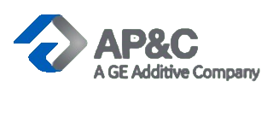





Slide 7
Customer Segment: Procurement managers & maintenance engineers at mid-size industrial operators Industry: Oil & Gas · Maritime · Naval/Defense · Utilities # of Interviews = 9
Hypothesis:
✓ VALIDATED
We believe the primary barrier to AM adoption in regulated industries is NOT technical capability — AM meets specs. The barrier is the absence of a certified, traceable pathway from digital file to approved part. Without this 'permission layer,' operators cannot adopt AM regardless of financial motivation.
Comments:
Tyler Beatty (ExxonMobil #33): "Value and capability exist — permission is what's missing." Lloyd's Register (Whitehouse, Saxty): LR certifies facilities, not individual parts — platform connects operators to pre-certified facilities. Aker Solutions (Humber, Davis): Canada gap is the missing link between procurement decision → qualified AM facility → LR certification milestone. Trevor Butler (LR #50): LR already informally acts as a supplier discovery service — the platform formalises that function.
Learnings & Insights:
Next Steps:
Certification must be designed in from day one — it cannot be retrofitted (Cindy Clark, WISC #66)
LR certifies the facility and process, not each print job — simplifies platform workflow significantly
LR already acts informally as supplier discovery service — platform formalises this
Operators across O&G, naval, maritime named the same gap independently and unprompted
Move LR & DNV conversations from validation → formal partnership MOU
Build Digital Birth Certificate into MVP as a non-negotiable core feature — not Phase 2
New hypothesis: operators will pay 10–20% sourcing premium for a pre-certified AM facility with DBC vs. standard quote
L2M

Slide 8
Customer Segment: Mid-size operators: 500–5,000 employees; field ops > 200 km from major supply hubs Industry: Oil & Gas · Utilities · Maritime Shipping · Naval/Defense # of Interviews = 7
Hypothesis:
✓ VALIDATED
We believe mid-size operators — not Tier-1 majors like ExxonMobil or Suncor — experience the most acute spare parts downtime pain. Tier-1 majors solved this through scale (massive inventories, helicopter logistics, global OEM relationships). Mid-size operators carry identical risk with none of the same infrastructure.
Comments:
Joy Romero (CNRL): Tier-1 majors are reference partners, not buyers — they've solved availability via scale. Dean Dalpe (Enbridge #64): cross-organisational inventory duplication is a major hidden cost lever. Jared Newcombe (Horizon Naval #65): strongest pilot candidate — specification ambiguity (not vendor response time) is the root cause of procurement bottlenecks. André Simha (MSC #59): maritime shipping confirms the pattern — Pelagus 3D's rise is market proof. Cindy Clark (WISC #66): "Their downtime was worth more than the part — so the math was easy."
Learnings & Insights:
Next Steps:
Tier-1 majors = credibility anchors and referral sources — NOT primary customers
Cross-organisational inventory duplication is a large hidden cost lever (Dean Dalpe, Enbridge)
Specification ambiguity — not vendor speed — is the root procurement bottleneck (Jared Newcombe)
Maritime sector confirms pattern: Pelagus 3D (on-vessel AM) is direct market validation
Define mid-size operator persona: 500–5K employees, downtime cost >$50K/day, field ops remote from supply hubs
Advance pilot conversation with Jared Newcombe (Horizon Naval) — most immediate pilot candidate
Test cross-organisational inventory pooling feature with Enbridge IT (referred by Dean Dalpe)
L2M

Slide 9
BUSINESS MODEL CANVAS
NAME: AddManuChain
ITERATION #: 3
Key Partners
Key Activities
Value Proposition
Customer Relationships
Customer Segments
Lloyd's Register · DNV · CSA (permission layer)
AM Facilities: Atlantic XL, Assembly PEI, Precise Design, InnsTek
OEMs — IP licensing (in development)
★ WISC · Canada Makes · NextGen Mfg Canada (GTM channels)
Polyunity
NRC-IRAP / ITB (certification funding)
★ AI inventory data normalisation ('Tomato Problem' solver)
AM facility matching + certification integration
Digital Birth Certificate issuance + traceability
★ Predictive maintenance → sourcing trigger pipeline
Platform development + maintenance
Customer discovery + iteration
For Operators: Know what you have. Source what you don't — certified, fast, traceable.
For AM Facilities: Pre-qualified jobs. Fill idle capacity without a sales team.
★ Supply chain traceability compliance (forced labour legislation tailwind)
★ Three entry points by customer cluster: AI normalisation (Phase 1) · Downtime protection (DBC + on-demand) · Compliance documentation (traceability legislation).
Self-serve digital platform (parts search + job order)
AM facility onboarding + account management
★ Association-sourced intros (WISC, Canada Makes)
Warm referral chains from executive interviews
PRIMARY: Mid-size operators — O&G · Maritime · Naval · Utilities (500–5K employees)
Aerospace and Satellite companies (GALAXIA, Reaction Dynamics)
★ Tier-1 majors = reference partners ONLY (ExxonMobil, CNRL, Equinor)
★ Commercial vehicle dealer networks (WISC / Daimler validation)
★ Maritime shipping fleets (MSC / André Simha validation)
Naval/defense repair (Horizon Naval, Irving Shipbuilding)
Key Resources
Channels
★ AI normalisation engine (Phase 1 — before AM network complete)
Certified digital part-file repository
Certification body partnerships (LR, DNV)
Domestic AM facility network (pre-certified)
Indurate Alloys materials expertise
LinkedIn + warm referral chains
★ WISC (cross-sector, outperforms sector-specific associations)
Canada Makes / NextGen Manufacturing Canada
Conference presence (offshore energy, Canada Makes events)
Cost Structure
Revenue Streams
AI engine development (normalisation + matching) · Platform hosting · Certification partnership integration · Customer discovery & BD · IP licensing framework
★ SaaS — AI inventory normalisation (Phase 1, standalone) · Transaction fee (% of certified AM job) · SaaS — operator on-demand sourcing access · Facility subscription (monthly pre-qualified jobs) · ★ Compliance-as-a-Service — supply chain traceability documentation
★ = New / changed from Sprint #1 iteration

Slide 10
Plan for Sprint #3
Next hypotheses · Stakeholders to interview · Key questions
Hypotheses | Stakeholder | Questions
AI.PRICE: Operators will pay a standalone SaaS subscription for AI inventory normalisation — before they need AM | Eashwar (Enbridge IT, referred by Dean Dalpe) · 2–3 supply chain / IT leads at mid-size operators | How many part numbers do you have for the same component across your systems? · What has it cost to fix this? · Would you pay $X/month for AI normalisation in 30 days?
PILOT.NAVAL: Finding a first company to accept the pilot deployment over their workflow | Jared Newcombe (Horizon Naval Engineering, COO) + team (or any other company) | Which part category first — obsolete, low-volume, or emergency? · Who approves a pilot internally? · What does success look like in 90 days?
PREDICT.TRIGGER: Integrating predictive maintenance → certified AM sourcing is an unserved market and AddManuChain is the right vehicle | Jason Power (Noble Corp — follow-up) · Jared Newcombe · Eashwar (Enbridge) | When IoT predicts failure 30 days out — what is your current sourcing process? · Where does it break down? · Do you want the trigger automated, or always human-approved?
AEROSPACE: WestJet / Havelin / Lufthansa Technik Calgary share the same spare parts downtime pain — WISC intros will open the door + Galaxia and Reaction Dynamics | WestJet procurement · Havelin · Lufthansa Technik Calgary (all via Cindy Clark warm intro) | Current process for sourcing hard-to-find or obsolete aircraft parts? · Average lead time? · If a certified AM alternative existed — what must it prove first?
COMPLIANCE: Creating a compliance forcing function for the Digital Birth Certificate | Policy / compliance leads at manufacturing SMEs · Government trade compliance contacts | What documentation do you need? · Would a DBC tracing a part from file to certified manufacturer satisfy this?
L2M

